Slide 1
Godliness in an ungodly world

Slide 2
Properly kitted out to address a gathering of Christadelphians
on the subject of
sexual immorality

Slide 3
Moral issues and their causes
Divine perspectives and solutions

Slide 4
“There is a way which seemeth right unto a man, but the end thereof are the ways of death.” Proverbs 14 v 12; 16 v 25

Slide 5
Moral Issues
Pornography*
Sexting (sharing of lewd images and conversation via mobile phones)*
Homo/bisexual exploration*
Sexual/homosexual activity outside of marriage both pre-marriage and during marriage*
Sexual/homosexual abuse
Allegations (plural!) of rape reported to the police
Young women self harming (90% correlation with any of the above issues)
*Now accepted by the community at large as appropriate/normal and to be encouraged (rather than shameful!) with consenting adult partners

Slide 6
All of these things are among us
Heritage college (upwards of a dozen students!)
Youth groups (10-20%!!)
Within ecclesias (all of them to my knowledge!!!)
Within families (how many?)

Slide 7
Immorality is ancient, but…
The current scale of the problem is alarming
The ease of accessing and sharing immoral images and ideas is unprecedented
Individuals, families (even entire ecclesias) are not up to speed or taking appropriate measures to be godly

Slide 8
Pornography – a hideous beast
Frequent and routine viewing of pornography and other sexualised images may:
contribute to young people forming unhealthy and sexist views of women and sex; and contribute to condoning violence against women.
There is also evidence to suggest an association between frequent viewing of online pornography and sexually coercive behaviour exhibited by young men.
Pornography consumption by young people may also normalise sexual violence and contribute to unrealistic understandings of sex and sexuality. These understandings shape social norms around sex, and may lead to young people feeling as though they should engage in the sexual behaviour frequently displayed in pornography, including violent acts.
Children and young people’s exposure to pornography, Australian Institute of Family Studies 4/5/2016
“conscience seared with a hot iron” 1 Timothy 4 v 2

Slide 9
“Do not let your heart turn aside to her ways - do not wander into her pathways; for she has brought down many fatally wounded, and all those she has slain are many.” Proverbs 7 v 25-26

Slide 10
Underlying causes of current problems
Human nature!
The time of the end?
Moral decline prophesied (but not anticipated?)
Lack of regular focused spiritual input?
Focus on exposition but not practical Bible study
Reticence/inability of parents and ecclesias to address
Focus on behaviour rather than hearts and minds

Slide 11
Human nature
“For from within, out of the human heart, come evil ideas, sexual immorality, theft, murder, adultery, greed, evil, deceit, debauchery, envy, slander, pride, and folly. All these evils come from within and defile a person.” Mark 7 v 21-23 NET

Slide 12
Parable of Israel
Shittim
“WHEN THE ISRAELITES WERE IN SHITTIM, (translator’s emphasis) the people began to have intercourse with Moabite women, who invited them to the sacrifices of their gods; and they ate the sacrificial food and prostrated themselves before the gods of Moab. The Israelites joined in the worship of the Baal of Peor and the LORD was angry with them.” Numbers 25 v 1-3 NEB

Slide 13
An issue predicted by the Lord
“And because iniquity shall abound...” Matthew 24 v 12
“And as it was in the days of Noe, so shall it be also in the days of the Son of man. They did eat, they drank, they married wives, they were given in marriage, until the day that Noe entered into the ark, and the flood came, and destroyed them all. Likewise also as it was in the days of Lot; they did eat, they drank, they bought, they sold, they planted, they builded; But the same day that Lot went out of Sodom it rained fire and brimstone from heaven, and destroyed them all. Even thus shall it be in the day when the Son of man is revealed.” Luke 17 v 26-30

Slide 14
The problem explored by Paul
2 Timothy 3 v 1-6
The last days
Perilous (difficult) times
The ecclesia not the world (v 5)

Slide 15
“Having a form of godliness but denying the power thereof”
‘They look holy but reject the ability [of God to change us]’
It is all about rules (legalism) and appearances (hypocrisy) and not about hearts and minds

Slide 16
Lack of regular spiritual input
God centred activities
Personal spiritual devotion
Family Bible based activities
Attendance at ecclesial meetings

Slide 17
Focus on exposition not life
A knowledge of the intricacies of scripture tends only to pride, self-righteousness and indifference UNLESS we take positive steps in love to learn and apply practical lessons for daily life from each area of study.
“Knowledge puffs up, but love builds up.” 1 Corinthians 8 v 1 NET

Slide 18
Reluctance of parents/ecclesias to address the issues
We don’t have the skills to handle it well… so we don’t
It is indelicate and embarassing… so we avoid it
Scripture deals with immorality and sexuality quite explicitly… and we often skip it.
“it is a shame even to speak of those things
which are done of them in secret.” (Ephesians 5 v 12)

Slide 19
Rules don’t change hearts “for what the Law could not do…”
Rules will not drive us to sin less
Perversely rules can inspire sin Romans 7 v 7-11
An unchanged heart is the source of sin
“For from within, out of the heart of men, proceed evil thoughts, adulteries, fornications…” Mark 7 v 21
“Chaperones don’t enforce morality,
they force immorality to be discreet” Judith Martin

Slide 20
Divine Perspectives

Slide 21
Seeing things from God’s perspective
Accepting God’s view as valid (trust)
Rejecting our view as invalid (humility)
“Trust in the LORD with all thine heart; and lean not unto thine own understanding. In all thy ways acknowledge him, and he shall direct thy paths. Be not wise in thine own eyes: fear the LORD, and depart from evil.” Proverbs 3 v 5-7

Slide 22
Wrong is Wrong
even if everybody is doing it
and
Right is Right
even if nobody is doing it

Slide 23
Divine perspectives on…
Morality
Sin
Consequences
Care
Restoration

Slide 24
Who should define sin and morality?
Human individuals?
Collective human agencies?
Majority human opinion?
God
“The heart is deceitful above all things, and desperately wicked: who can know it?” Jeremiah 17 v 9
“There is a way that seemeth right unto a man, but the end thereof are the ways of death.” Proverbs 16 v 25

Slide 25
God and righteousness
It is not that God will always act rightly (though that of course is true) so much as that right is defined by God
“that which is right and good in the sight of the LORD”
Deuteronomy 5 x
+ nearly a dozen more in Kings and Chronicles

Slide 26
Why does God have rules?
“If thou wilt diligently hearken to the voice of the LORD thy God, and wilt do that which is right in his sight, and wilt give ear to his commandments, and keep all his statutes, I will put none of these diseases upon thee, which I have brought upon the Egyptians: for I am the LORD that healeth thee.” Exodus 15 v 26
“Honour thy father and mother; (which is the first commandment with promise;) That it may be well with thee, and thou mayest live long on the earth.” Ephesians 6 v 2-3
The promise is mostly fulfilled in the observance (cause and effect)

Slide 27
Sin
What is it?
Why has God declared it to be bad?
Why didn’t God legislate in favour of sexual immorality?
Is God some sort of divine ‘party pooper’?

Slide 28
Sin is behaviour in which…
We fall short of the standard God demands
of those worthy to be included in his family
through things we do or fail to do
and thereby
limits our and/or others participation
in God’s purpose
causing harm to God and his children
(Leviticus 6 v 2, Romans 3 v 23, 1 Corinthians 6 v 8, Hebrews 12 v 15)

Slide 29
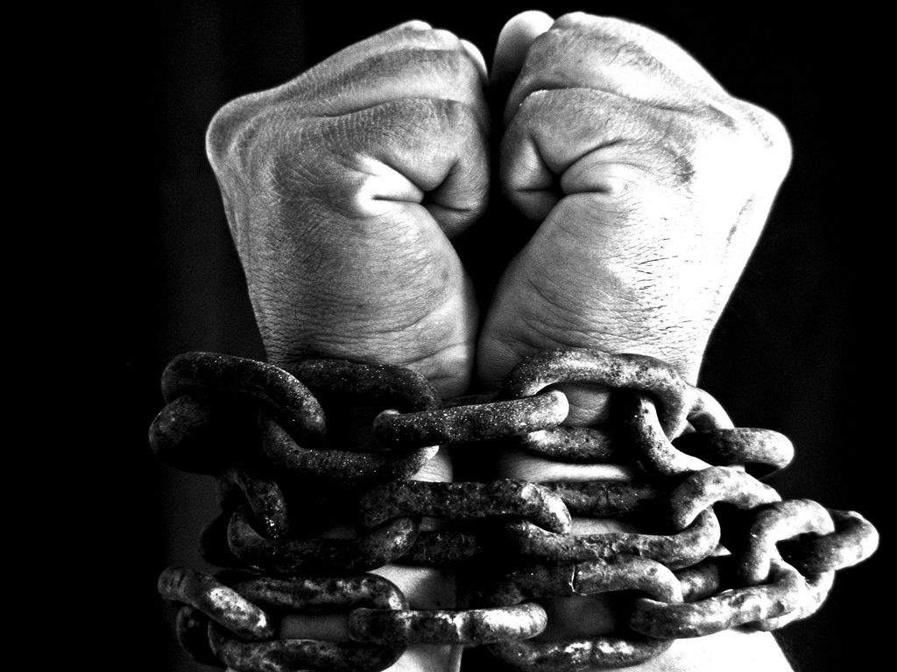
Sin is therefore…
Anti-social
Destructive
Damaging
Enslaving
Not to mention “the wages of sin” which disqualifies one from inheriting life with God.

Slide 31
Sexual sin is destructive and always hurts someone! It grieves a holy God, it often brings disease to our bodies. It deeply affects our personalities and fills us with shame.
“the immoral person sins against his own body.” 1 Corinthians 6 v 18 NET

Slide 32
All sin is equally bad in the sight of God, but…
The social consequences of moral sin and the damage it causes are so significant that the penalties applied under the law of Moses were very severe.
While forgiveness can (and should be) extended for moral sins the consequences remain and need to be appreciated

Slide 33
Repentance and forgiveness do not remove consequences
“And the LORD said, I have pardoned according to thy word: But… all those men which have seen my glory, and my miracles, which I did in Egypt and in the wilderness, and have tempted me now these ten times, and have not hearkened to my voice; Surely they shall not see the land which I sware unto their fathers, neither shall any of them that provoked me see it:” Numbers 14 v 20-22

Slide 34
Repentance and forgiveness do not remove consequences
“And David said unto Nathan, I have sinned against the LORD. And Nathan said unto David, The LORD also hath put away thy sin; thou shalt not die. Howbeit, because by this deed thou hast given great occasion to the enemies of the LORD to blaspheme, the child also that is born unto thee shall surely die.” 2 Samuel 12 v 13-14

Slide 35
Don’t underestimate the personal damage that moral sin will cause
“Whoso committeth adultery with a woman lacketh understanding: he that doeth it destroyeth his own soul. A wound and dishonour shall he get; and his reproach shall not be wiped away.”
Proverbs 6 v 33

Slide 36
The Divine example of care
“For the LORD your God is God of gods, and Lord of lords, a great God, a mighty, and a terrible, which regardeth not persons, nor taketh reward: He doth execute the judgment of the fatherless and widow, and loveth the stranger, in giving him food and raiment.” Deuteronomy 10 v 17-18
“He (Josiah) judged the cause of the poor and needy; then it was well with him: was not this to know me? saith the LORD.” Jeremiah 22 v 17
According to James the cries of the vulnerable enter “into the ears of the Lord of Sabaoth” (James 5 v 4)

Slide 37
God’s children
“Children are an heritage of the LORD” Psalm 127 v 3
Literally in Hebrew
‘Children are Yahweh’s possession’

Slide 38
The Lord’s teaching Matthew 18 v 1-10
Children are valuable
Angels (of God’s presence!) care for children
Care of children is equated to care for Christ!
Children can/will be harmed
Those who harm children are totally lost (but see v 11)

Slide 39
Recovering the sinner
Confession
Contrition
Repentance
Forgiveness
Renewal of a right spirit
Salvation
(Joshua 7 v 19-20, 2 Samuel 12 v 13,
Psalm 51 v 1-12, James 5 v 16-20, 1 John 1 v 8-9)

Slide 40
Areas for collective improvement
Make families/ecclesias safe for children and young people (physically, morally & spiritually)
Provide God-centred moral education appropriate for the times in which we live
Give practical Bible study to facilitate godliness
Care for the victim rather than the reputation of the individual/ecclesia/community
Manage moral sinners appropriately and seek to recover them in a spirit of meekness

Slide 41
“But you my friends are forewarned. Take care, then, not to let these unprincipled men seduce you with their errors; do not lose your own safe foothold. But grow in grace and in the knowledge of our Lord and Saviour Jesus Christ” 2 Peter 3
v 17-18 NEB

